Slide 1
Intelligent MultiDoc QnA Platform Using LangChain
TEAM MEMBERS
CHARAN VIGNESH N R – 312320205021
RAKESH K - 312320205114
PROJECT MENTOR
Mr. RADHAKRISHNAN K R

Slide 2
PROBLEM STATEMENT
The current challenge is to overcome knowledge base restrictions and provide a solution for processing multiple users' documents to generate insights, analysis, and summaries.
This requires the use of Open Source large language models such as Llama 2 and to models from Huggingface to create a web platform that allows users to upload documents, extract embeddings, and engage in a private Chatbot interaction for enhanced information retrieval and analysis.

Slide 3
OBJECTIVES
We have created a Web Platform to upload multiple user’s documents to process and answer questions from it.
It is done by using LangChain by combining multiple LLM’s together like ChatGPT for creating the chat-chain and Huggingface for processing (extracting embeddings) of the documents.
Through this, we can achieve our own private ChatGPT which can be used for getting insights, analysis, summaries, etc…
By using this architecture we can overcome the problem of knowledge base restrictions and can give our own knowledge base.

Slide 4
INTRODUCTION TO DOMAIN
Natural Language Processing (NLP) techniques are changing how people interact with machines and how information is processed. The platform's use of transformer-based models demonstrates NLP's aptitude for contextual understanding, allowing accurate responses by converting into relevant context. Through enhanced similarity matching, this technology enables effective handling of a variety of question types and prompt identification of pertinent information. By bridging the gap between human understanding and machine processing, NLP's transformative capabilities enable seamless communication and well-informed decision-making. From complex legal analyses to research projects, NLP's contextual expertise boosts productivity and insight, demonstrating its profound influence on improving knowledge extraction from text and enhancing a variety of applications.

Slide 5
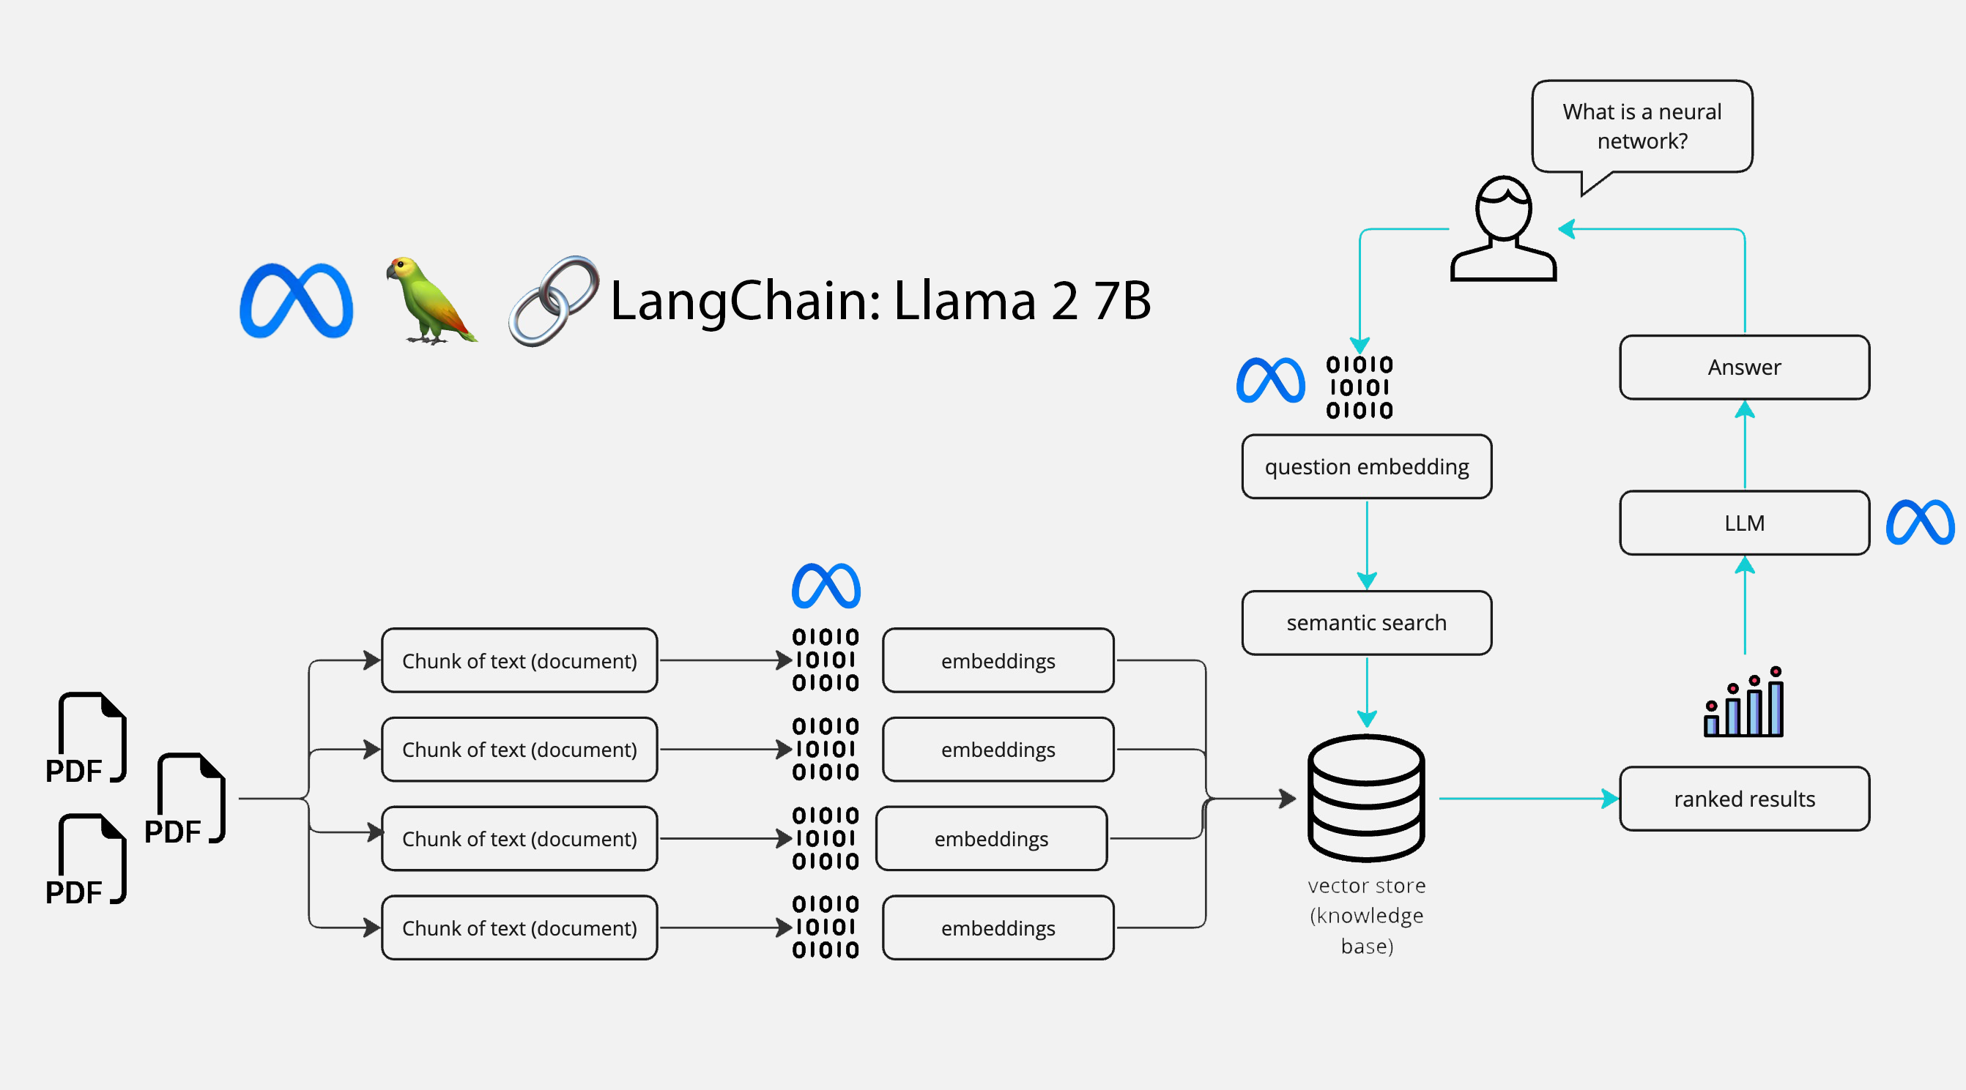
ARCHITECTURE

Slide 6
LITERATURE REVIEWS
AUTHOR | YEAR | PRINCIPLE | PROS AND CONS
Xiang Dong and Lijia Zeng | 2021 | Query Optimization | PROS Efficient Knowledge Extraction CONS Data Dependency
Michael L. Rupley, Jr. Indiana University at South Bend | 2022 | Query Processing and Optimization | PROS Improved Performance CONS Complex Implementation
AUTHOR | YEAR | PRINCIPLE | PROS AND CONS
Ryan Marcus , Parimarjan Negi , Hongzi Mao , Chi Zhang, Mohammad Alizadeh , Tim Kraska, Olga Papaemmanouil1 , Nesime Tatbul Brandeis University MIT Intel Labs | 2020 | Enhanced Cardinality Estimation | PROS Adaptive Learning CONS Data Dependency
Liwei Yan, Bo Bai, Member, IEEE, Wei Chen, Senior Member, IEEE, and Dapeng Oliver Wu, Fellow, IEEE | 2019 | SVM classification and iterative refinement | PROS Enhanced Performance CONS Complex Implementation
Abdul Wahab Qurashi (abdul.qurashi@hud.ac.uk) and Anju P. Johnson (a.johnson@hud.ac.uk) | 2023 | Automate railway safety document utilizing word embeddings | PROS Risk Mitigation CONS Data Quality Dependency

Slide 7
AUTHOR | YEAR | PRINCIPLE | PROS AND CONS
Ahmad Amin; Toqir A. Rana; Natash Ali Mian; Muhammad Waseem Iqbal; Abbas Khalid; Tahir Alyas | 2019 | The algorithm employs unsupervised techniques, utilizing keyphrase extraction, to predict topics in Urdu documents, facilitating organization, summarization, and title assignment, particularly addressing challenges posed by evolving online news and the complexity of the Urdu language. | PROS Efficient Information Retrieval Automated Title Assignment Broad Applicability CONS Semantic Complexity Resource Intensity
Louis R Pasquale, MD Department of Ophthalmology Icahn School of Medicine at Mount Sinai | 2023 | This analysis utilizes search-engine query patterns, specifically search queries, to predict regional COVID-19 outbreaks early, offering real-time insights into health-seeking behavior at a population level and enhancing traditional outbreak detection methods. | PROS Real-Time Insights Supplemental Forecasting Predictive Value CONS Historical Inaccuracies Bias and Privacy Concerns
Stella Biderman Hailey Schoelkopf Quentin Anthony Herbie Bradley Kyle O’Brien Eric Hallahan Mohammad Aflah Khan Shivanshu Purohit USVSN Sai Prashanth Edward Raff Aviya Skowron Lintang Sutawika Oskar van der Wal | 2020 | Pythia is a suite designed to analyze large language models' behavior across training and scaling, addressing the need for understanding their performance in various domains, including NLP, and bridging the gap caused by the absence of suitable model suites for research. | PROS State-of-the-Art Performance Innovative Applications Scalability Insights CONS Limited Understanding Data and Bias Challenges

Slide 8
REFERENCES
Research on Query Optimization of Classic Art Database Based on Artificial Intelligence and Edge Computing - Xiang Dong and Lijia Zeng - 2021
Introduction to Query Processing and Optimization - Michael L. Rupley, Jr. Indiana University at South Bend - 2022
Neo: A Learned Query Optimizer - Ryan Marcus , Parimarjan Negi , Hongzi Mao , Chi Zhang, Mohammad Alizadeh, Tim Kraska, Olga Papaemmanouil1, Nesime Tatbul Brandeis University MIT Intel Labs - 2020
New Word Extraction From Chinese Financial Documents - Liwei Yan, Bo Bai, Member, IEEE, Wei Chen, Senior Member, IEEE, and Dapeng Oliver Wu, Fellow, IEEE - 2019
New Avenues for Automated Railway Safety Information Processing in Enterprise Architecture: An NLP Approach - Abdul Wahab Qurashi and Anju P. Johnson - 2023
A Novel Unsupervised Approach for Topic Prediction Using Keyphrase Extraction for Urdu Documents - Ahmad Amin; Toqir A. Rana; Natash Ali Mian; Muhammad Waseem Iqbal; Abbas Khalid; Tahir Alyas - 2019
Analysis of Search-Engine Query Patterns - Louis R Pasquale, MD Department of Ophthalmology Icahn School of Medicine at Mount Sinai - 2023
Pythia: A Suite for Analyzing Large Language Models Across Training and Scaling - Stella Biderman Hailey Schoelkopf Quentin Anthony Herbie Bradley Kyle O’Brien Eric Hallahan Mohammad Aflah Khan Shivanshu Purohit USVSN Sai Prashanth Edward Raff Aviya Skowron Lintang Sutawika Oskar van der Wal – 2020

Slide 9
THANK YOU

